Slide 1

Wojciech Kaczmarski, SP5WWP
M17 Project
m17project.org

Slide 2
What is M17?
A digital protocol designed by hams, for hams
A response to growing community of digital mode users
A way to get free from patent encumbrances, licenses etc.
A chance to bring back digital radio to the experimenting side of amateur radio

Slide 3
Codec 2 adoption
FreeDV – HF, low rates
M17 – VHF and up, higher rates

Slide 4
M17 specification
spec.m17project.org

Slide 5
M17 features
IDs are based on callsigns (no user ID database needed)
16 Channel Access Numbers
AES encryption support
Packet/stream modes
Simplified radio/codeplug config

Slide 6
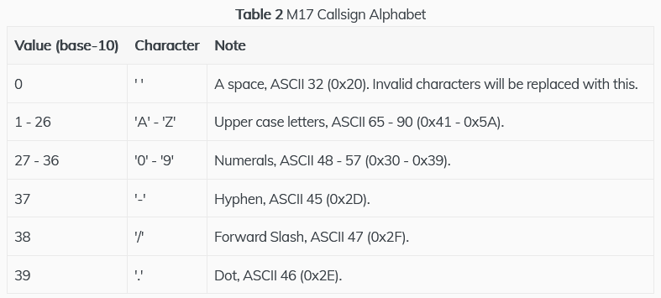
Address encoding
Ex.: “AB” → 40*2+1=81, “M17” → 40^2*34+40*28+13=55533

Slide 7
Physical layer
4-FSK, 9 kHz wide, 12.5 kHz channels
4800 symbols per second, 9600 bps gross
Error-control coding
FDMA

Slide 8
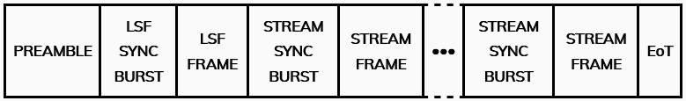

Slide 9
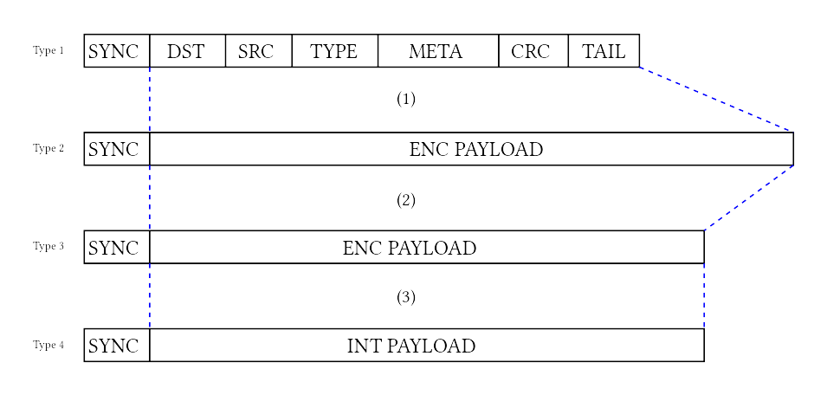
Link Setup Frame (LSF)

Slide 10
Link Setup Frame (LSF)

Slide 11
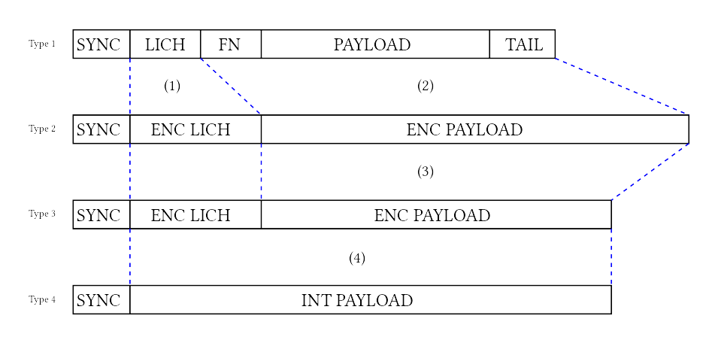
Voice frame

Slide 12
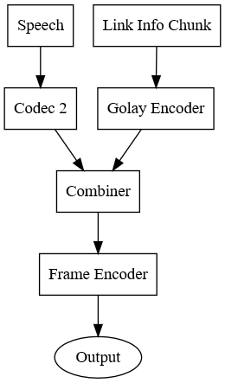

Slide 13
Error-control coding
Golay (24, 12) – LICH
Punctured convolutional coding - frames

Slide 14
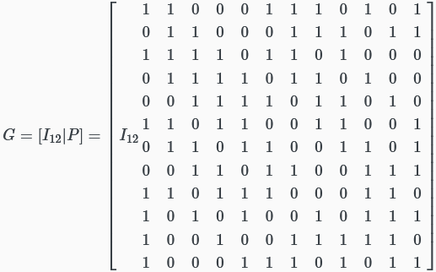
Error-control coding
Ext. Golay (24, 12)
48 → 96

Slide 15
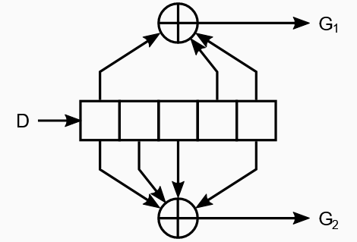


Error-control coding
Punctured convolutional coding, K=5

Slide 16
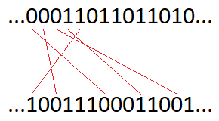
Bit interleaver

Slide 17
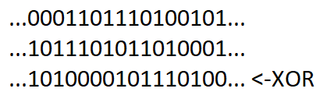
Bit randomizer
← Data input
← Randomizing seq

Slide 18
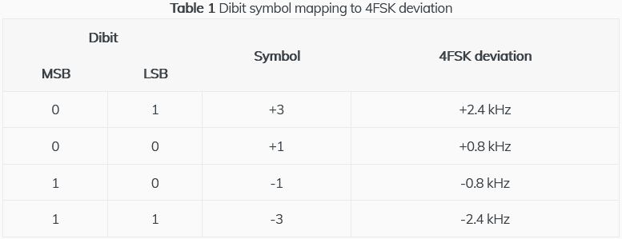

Slide 19
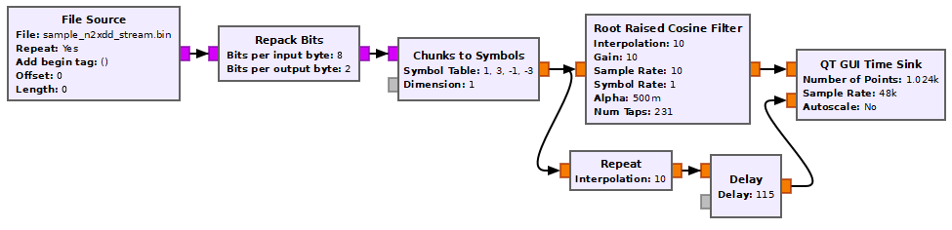

Slide 20
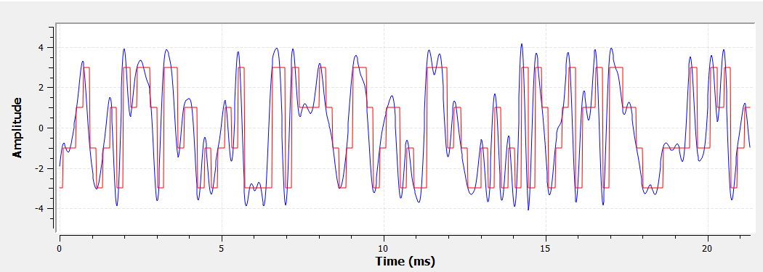

Slide 21
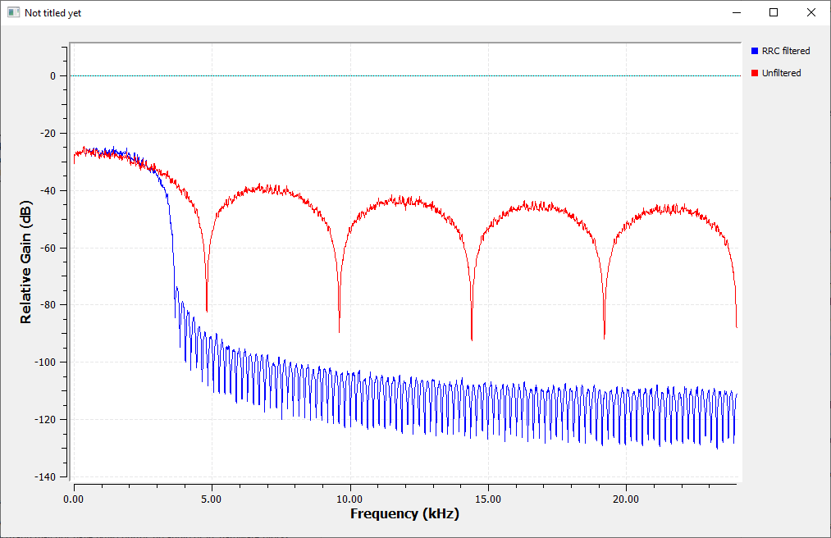

Slide 22
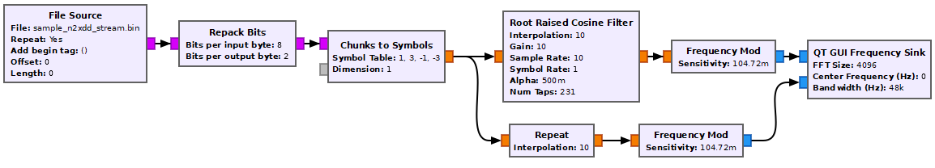

Slide 23
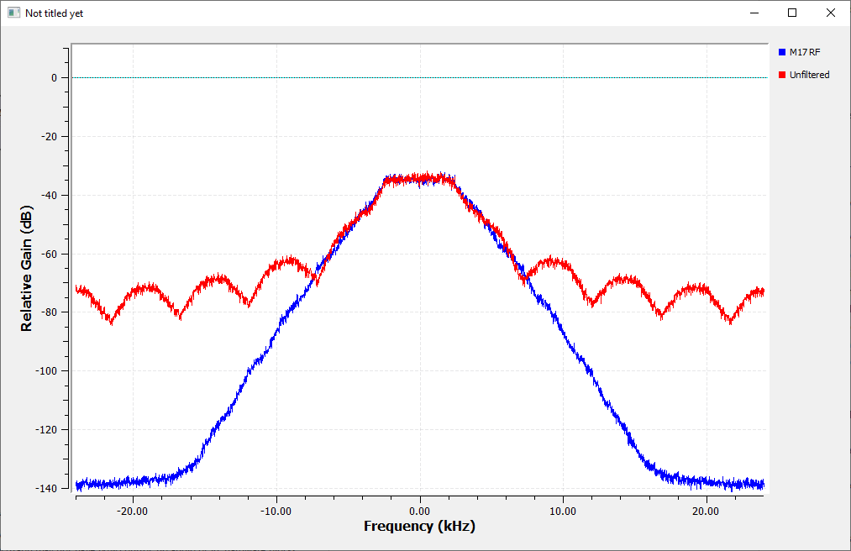

Slide 24
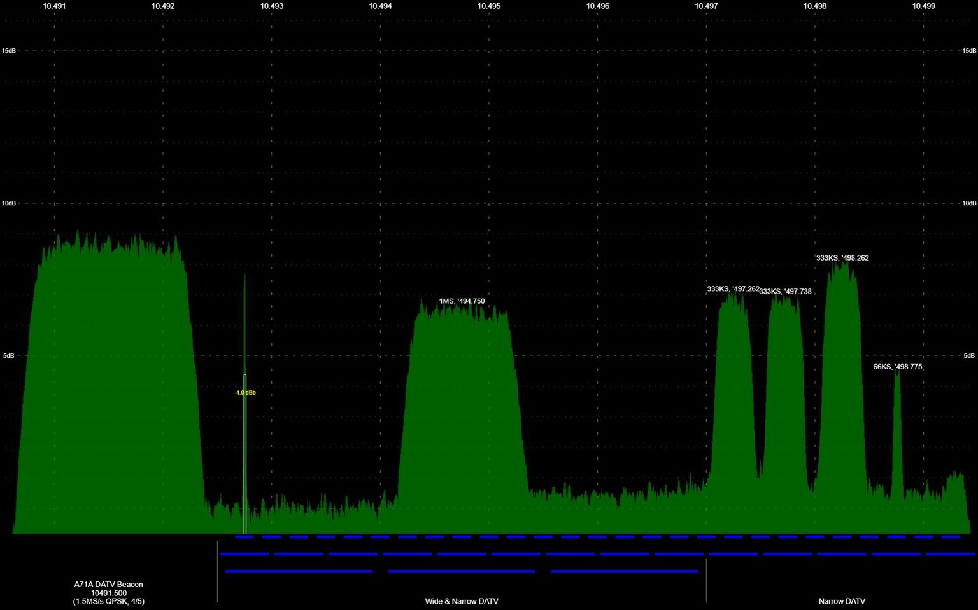
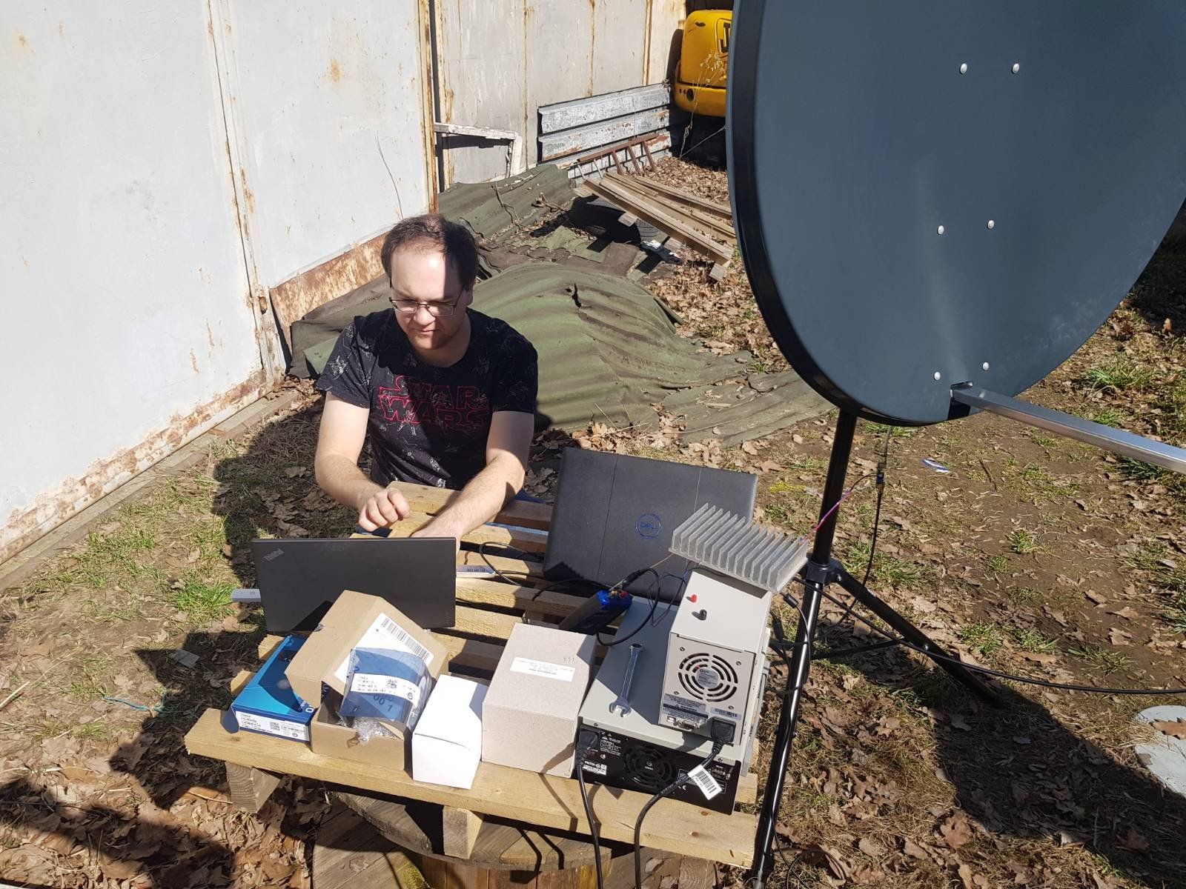
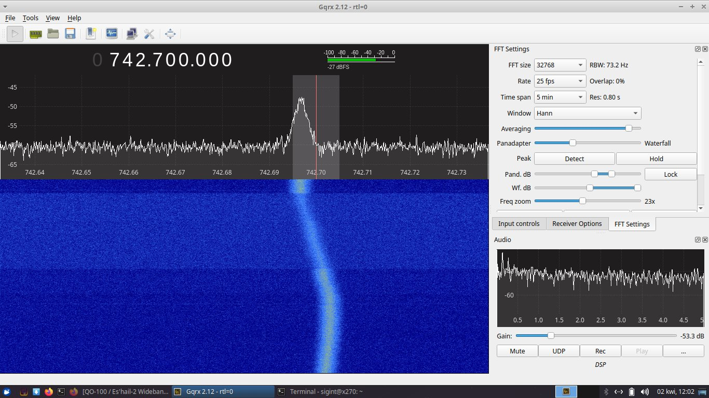

Slide 25
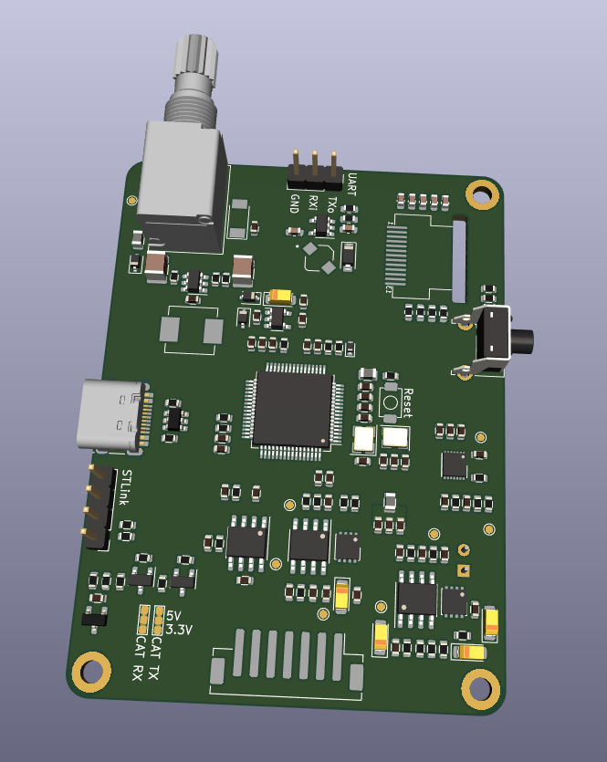
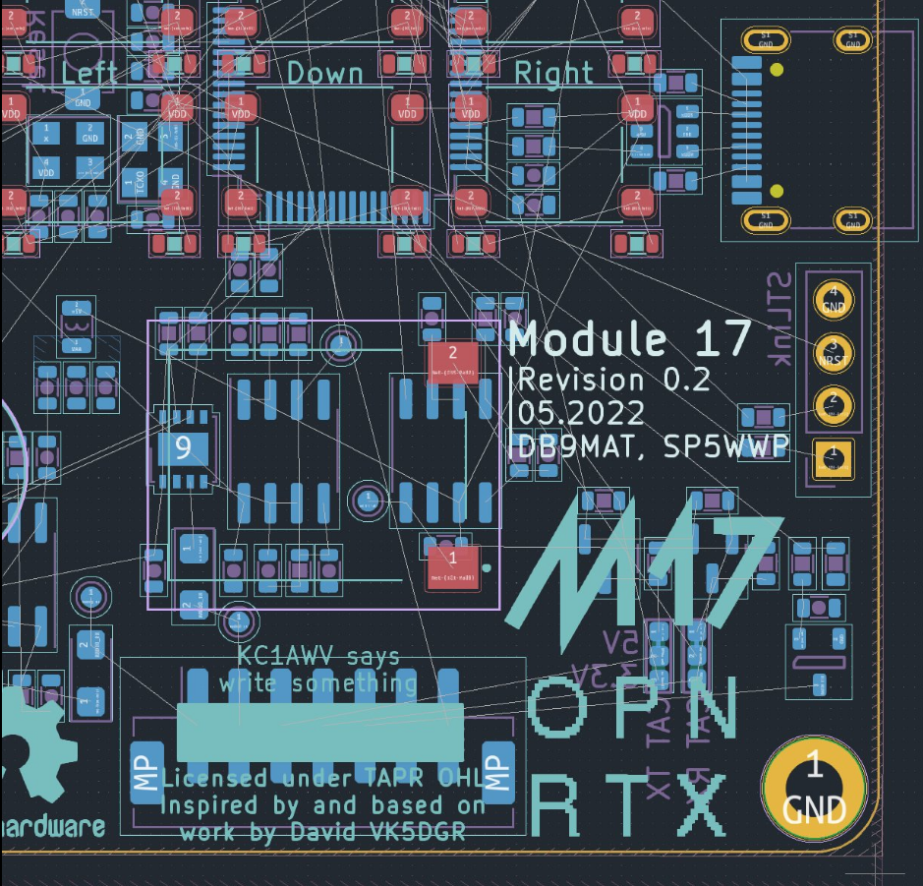

Slide 26
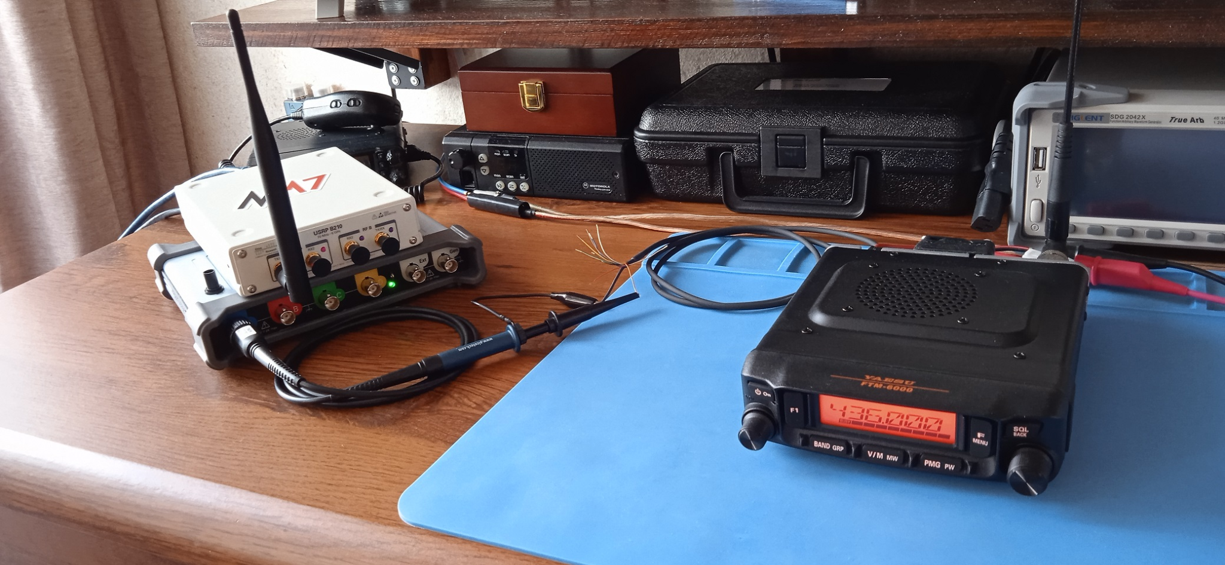
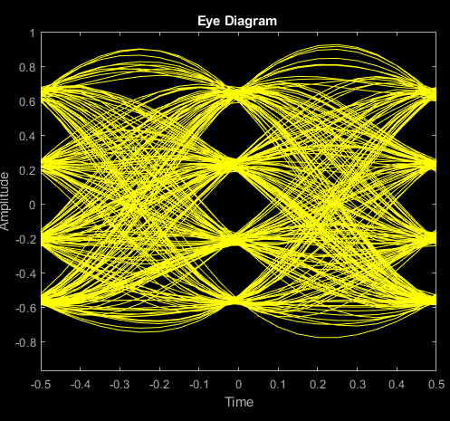

Slide 27
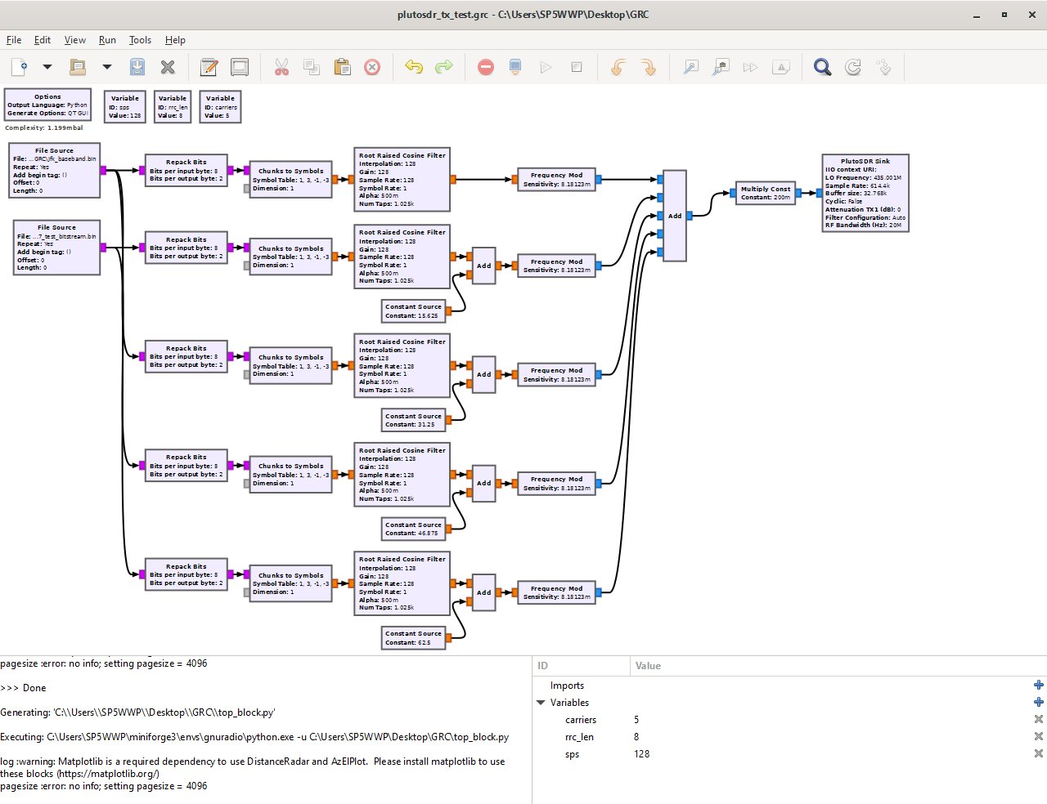
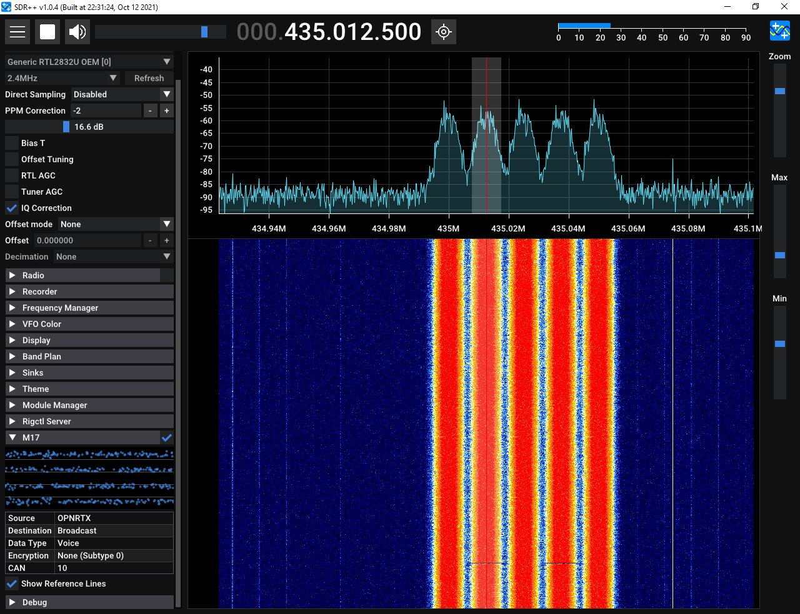

Slide 28
“After two decades of being tied to closed source vocoders, the amateur radio is attracted to open source vocoders for next generation radio systems”
David Rowe, VK5DGR

Slide 29
Questions?

